Slide 1



Power Platform Governance Secure your Platform

Slide 2
Disclaimer

Slide 3
Who Are The Power Platform Users?
1
END USERS
2
PRO-DEV/IT PRO
Lower barrier of entry
Power users in business units close to the problem building solutions for their teams
Often with IT oversight or in an approved sandbox
Enables high productivity
Reduces time to develop and deploy
Centrally managed and rolled out
Some organizations start with a centralized IT apps and then grow into organic development
Far more start with organic solutions in business units and grow into a centralized IT CoE
Notes:
As we alluded to, Power Platform is designed for several personas. The primary users are end users and pro devs as well as IT personnel. End users are usually close to many of the business problems that organizations experiences, thus know what types of solutions are needed. Pro Dev and IT Pros leverage the Power Platform to scale and enhance their productivity and capabilities while also having central management and control of the platform.

Slide 4

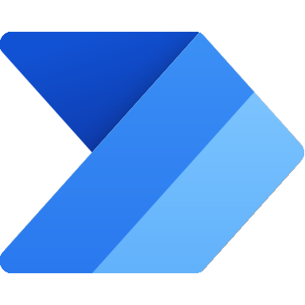



1
Azure Active Directory
Tenant access & isolation
TENANT
Dev
Test
2
Environment
Prod
Environment access & strategy
3
Resource permissions
Power Apps
Power Automate
Power Virtual Agents
4
Connector access and data loss policies
Connectors
5
Dataverse security
Dataverse
6
On-premises data gateway
On-premises data gateway
Notes:
There are multiple layers to your security. Security begins at the tenant level and then cascades down to other elements. With regard to the Power Platform, there are security layers for Environments, resources, and the common data service. Also, it is important to ensure security across tenants. All organizations conduct business with partners and peers, and security data across organizations is as important as securing the data within your organization.

Slide 5
Tenant level service admin roles
1
Global Admin
Full administration to all services in tenant
Power Platform Admin
Dynamics 365 Admin
Power Platform Admin role
Delegated Admin
Full administration to all services in tenant
Used for partners to provide support to customers
Full support for Power Platform
Notes:
Define your organizational roles to ensure that appropriate people have the right permissions for their required roles.

Slide 6


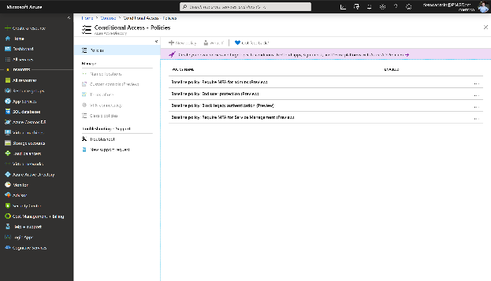
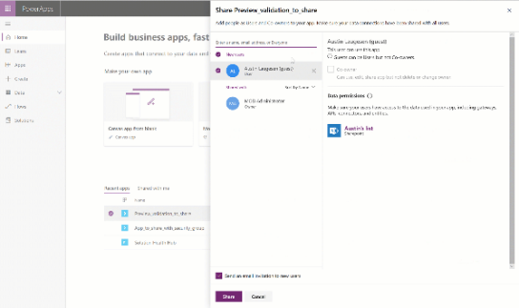

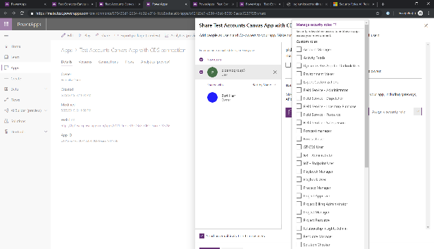
Identity management with Azure Active Directory
1
Using Azure Active Directory session and conditional access policies to manage timeout and access requirements. (more details in upcoming slides)
Share apps with external users with Azure Active Directory B2B collaboration.
Use Azure Active Directory groups to manage/share apps and data access.
Notes:
Define your organizational roles to ensure that appropriate people have the right permissions for their required roles.

Slide 7
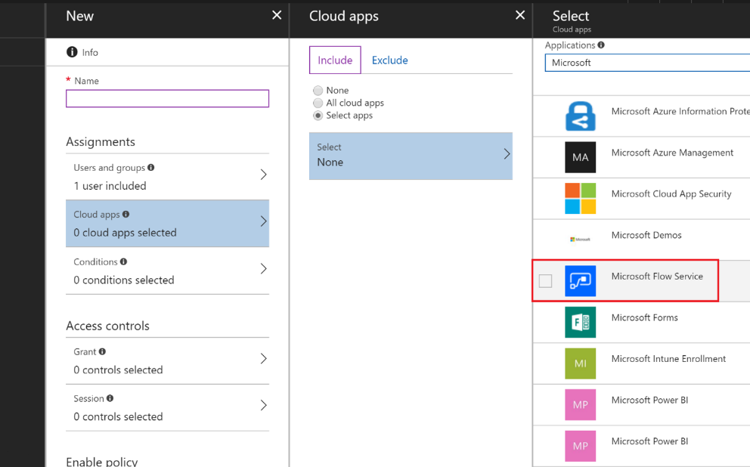
Conditional service access
1
Azure AD
Conditional Access Policies
Azure AD Premium license required
Grant/block access to Power Apps and Power Automate services based upon
Conditional Access on individual apps (preview)
Apply Conditional Access policies to individual Power Apps (only canvas apps are supported in preview)
User/Group
User/Group
Power Automate
Device
Location
Notes:
Azure Active Directory (Azure AD), one of the world’s most sophisticated, comprehensive, and secure identity and access management services. Azure AD helps secure the citizen developer by protecting against identity compromise, gives the IT admin/pro visibility and control, and offers additional security capabilities for the pro developer. Azure AD helps support the least privilege strategy. Azure AD also follows a federated model, so organizations not directly using the service are still secure. Authentication to Power Automate and Power Apps is via Azure AD, admins using its premium features can create conditional access policies which restrict user access to only the apps and data relevant for their role. Power Automate and Power Apps integration with Azure AD also enhances security for more experienced developers who can register applications with the service and leverage multiple authentication protocols, including the OAuth2 authorization framework to enable their code to access platform APIs. This access protection can also be extended to external users.

Slide 8
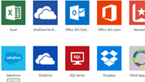
Cross-tenant inbound & outbound restrictions
1
Default Configuration
CUSTOMER TENANT CONTOSO
Contoso User can establish
a connection using Fabrikam credentials
PowerApps
Flows
PowerApps
Flows
Fabrikam user can establish a connection
using Contoso credentials
3rd PARTY TENANT FABRIKAM
Notes:
Traditionally, companies restrict domain names or IP addresses when they want to manage access. This approach fails in a world where software as a service (or SaaS) apps are hosted in a public cloud, running on shared domain names like outlook.office.com and login.microsoftonline.com. Blocking these addresses would keep users from accessing Outlook on the web entirely, instead of merely restricting them to approved identities and resources.
The Azure Active Directory (Azure AD) solution to this challenge is a feature called tenant restrictions. With tenant restrictions, organizations can control access to SaaS cloud applications, based on the Azure AD tenant the applications use for single sign-on. For example, you may want to allow access to your organization’s Office 365 applications, while preventing access to other organizations’ instances of these same applications.
With tenant restrictions, organizations can specify the list of tenants that their users are permitted to access. Azure AD then only grants access to these permitted tenants.

Slide 9
Cross-tenant Access – Restrict outbound
1
https://aka.ms/adtenantrestrictions → this applies to all Azure AD Cloud SaaS app
CUSTOMER TENANT CONTOSO
Contoso User is blocked from connecting using Fabrikam credentials
PowerApps
Flows
PowerApps
Flows
Fabrikam user can establish a connection
using Contoso credentials
3rd PARTY TENANT FABRIKAM
Notes:
https://aka.ms/adtenantrestrictions

Slide 10
Cross-tenant Access – Restrict inbound
1
Requires support ticket today → this restriction only applies to PowerApps and Power Automate
CUSTOMER TENANT CONTOSO
Contoso User can establish
a connection using Fabrikam credentials
PowerApps
Flows
PowerApps
Flows
Fabrikam user is blocked connecting using Contoso credentials
3rd PARTY TENANT FABRIKAM
Notes:
https://aka.ms/adtenantrestrictions

Slide 11
Cross-tenant inbound & outbound restrictions
1
Requires support ticket today → this restriction only applies to PowerApps and Power Automate
CUSTOMER TENANT CONTOSO
Contoso user is blocked connecting using Fabrikam credentials
PowerApps
Flows
PowerApps
Flows
Fabrikam user is blocked connecting using Contoso credentials
3rd PARTY TENANT FABRIKAM
Notes:
https://aka.ms/adtenantrestrictions

Slide 12
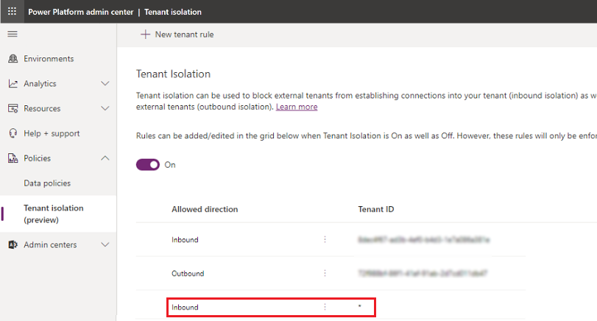
Tenant Isolation from Power Platform Admin Center (Preview)
Current in preview and available in Power Platform Admin Center, Policies > Tenant isolation.
New Tenant Rule can be created for Inbound and/or Outbound Restriction once Tenant Isolation is turned on
Tenant domain or ID to be added to the Allowed list, you can use * for all tenants.
Users who create or edit a resource affected by the tenant isolation policy will see a related error message.
Existing Apps or flows that are in violation of the tenant isolation policy won't run successfully
1
Notes:
https://docs.microsoft.com/en-us/power-platform/admin/cross-tenant-restrictions

Slide 13
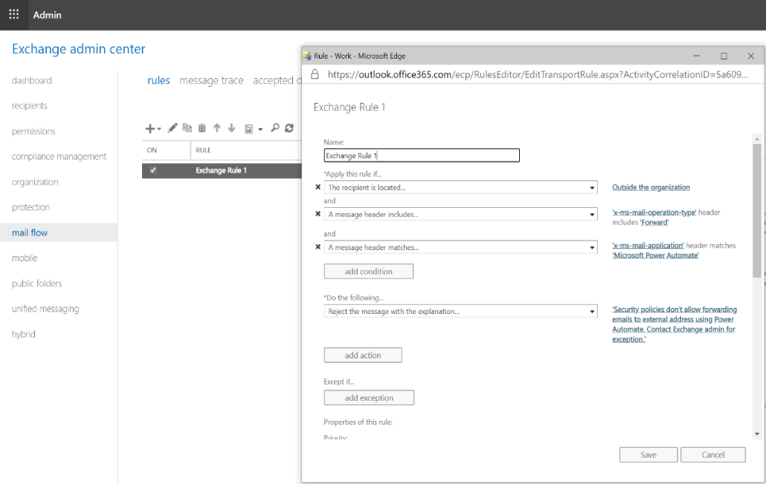

Conditional service access
1
Email exfiltration blocking for O365 Outlook Connector
SMTP header “x-ms-mail-application” to identify – Microsoft Power Automate or Microsoft Power Apps – as the client
User/Group
SMTP header “x-ms-mail-operation-type” to identify – Forward, Reply or Send – as message operation.
Exchange mail flow rules can be set up to filter appropriate message.
Individual apps or flows can be exempted by using User-Agent ID in the SMTP header
Notes:
Azure Active Directory (Azure AD), one of the world’s most sophisticated, comprehensive, and secure identity and access management services. Azure AD helps secure the citizen developer by protecting against identity compromise, gives the IT admin/pro visibility and control, and offers additional security capabilities for the pro developer. Azure AD helps support the least privilege strategy. Azure AD also follows a federated model, so organizations not directly using the service are still secure. Authentication to Power Automate and Power Apps is via Azure AD, admins using its premium features can create conditional access policies which restrict user access to only the apps and data relevant for their role. Power Automate and Power Apps integration with Azure AD also enhances security for more experienced developers who can register applications with the service and leverage multiple authentication protocols, including the OAuth2 authorization framework to enable their code to access platform APIs. This access protection can also be extended to external users.

Slide 14
1
Azure Active Directory
Tenant access & isolation
TENANT
Dev
Test
2
Environment
Prod
Environment access & strategy
3
Resource permissions
Power Apps
Power Automate
Power Virtual Agents
4
Connector access and data loss policies
Connectors
5
Dataverse security
Dataverse
6
On-premises data gateway
On-premises data gateway
Notes:
There are multiple layers to your security. Security begins at the tenant level and then cascades down to other elements. With regard to the Power Platform, there are security layers for Environments, resources, and the common data service. Also, it is important to ensure security across tenants. All organizations conduct business with partners and peers, and security data across organizations is as important as securing the data within your organization.

Slide 15

Environment security and access control
Access to resources are controlled using
Environment roles (Maker/Admin)
Resource permissions for apps/flows/custom connectors/etc.
Environment Admin can perform all administrative actions like
View/manage resources
Add/remove a user or group from roles
Create DLP policies
Provision Dataverse database to envs
Environment Maker can create resources within an environment and distribute apps and flows they build using share functionality
2
Environment without Dataverse
Environment Roles
(Maker/Admin)
App
Flow
Resource Permissions
(Owner/Contributor/User…)
Custom Connector
Once a Dataverse database has been created, the Dataverse security roles take over for controlling security
Environment with Dataverse
Environment Roles
(Maker/Admin)
App
Resource Permissions
(Owner/Contributor/User…)
Access to resources are controlled using
Dataverse security roles
Resource permissions for apps/flows/custom connectors/etc.
Learn more about Dataverse security roles from here
Flow
Custom Connector
Environment & Dataverse Roles
(Maker / System Admin Customizer…)
Dataverse
Notes:
Securing access to the environment is critical to successfully governing the organization. Access is controlled by the assigned environment roles, the resource permissions, and CDS security roles. The CDS security roles of course control the security for the CDS database.

Slide 16
Key out-of-box security roles you need to know
2
Environment Admin/System Administrator
System Customizer
Environment Maker
Basic User
Notes:
There are four roles that can be assigned in an environment which ensures granting privileges and permissions to users based on their job function.
Environment Admin/System Administrator
Complete ability to customize and administer the environment
Full read-write access to data in the database
The role cannot be modified
Care should be taken in assigning this to the right people
System Customizer
Full permission to customize the environment
Data access is focused only on data owned by the user
Role can be modified but it is not recommended to modify
Environment Maker
Create new resources in the environment including apps, connections, gateways and flows
There is no default privileges to data included
Role can be modified but it is not recommended to modify
Basic User
Basic user role, with ability to run apps and perform common tasks but no ability to customize the system
The data access is focused on Read access to most Common Data Model core entities with full access to records owned by the user (i.e. ‘self’ privileges)
Good role to copy to make a custom security role for users

Slide 17
Looking inside environments
2
Azure AD
Tenant
PowerApps
Default
Environment
PowerApps
Environment
Model Driven PowerApps
Entities
SharePoint
PowerApps
PowerApps
Data
verse
Process Flows
Teams
Flows
Flows
Exchange
Business Rules
Excel
Security Model
Microsoft Azure
Azure AD
Data Gateway(s)
Logic Apps
Functions
Management API
Storage
On Premise Systems
On Premise Gateway(s)
Databases
Web API
SharePoint Data
File Storage
Notes:
There are no limitations to the number of apps or flows that can be deployed within an environment
Default environment can also now have a CDS database
Gateways, which leverage a common service that spans Power platform (& includes PowerBI), are enabled, by default, only in the default environment
There is a process (initiated via support ticket) for manually migrating a gateway to a non-default environment.
We plan to provide a self-service way to support gateways in non-default environments by April 2019.

Slide 18

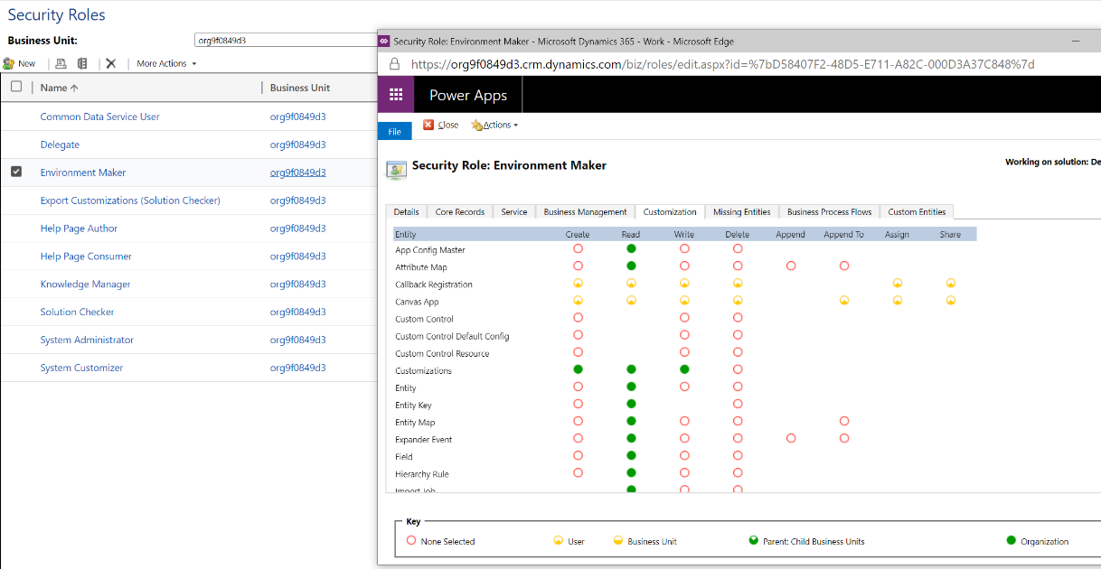
Customizing Security Roles
2
If your app uses a custom table, its privileges must be explicitly granted in a security role before your app can be used. You can either add these privileges in an existing security role or create a custom security role.
Notes:
Securing access to the environment is critical to successfully governing the organization. Access is controlled by the assigned environment roles, the resource permissions, and Dataverse security roles. The Dataverse security roles of course control the security for the Dataverse database.

Slide 19
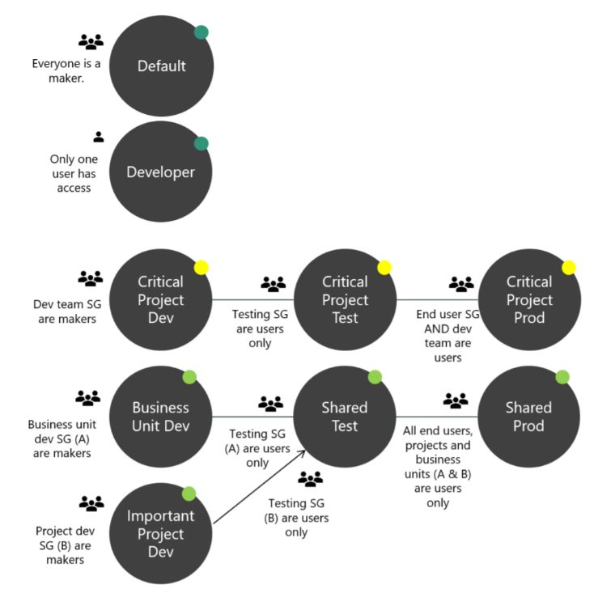
2
Strategy for establishing secure environments
Security checklist (learn more here):
Assign your admins the Power Platform service admin role.
Restrict the creation of net-new trial and production environments to admins.
Treat the default environment as a ‘Personal productivity’ environment.
Establish a process for requesting access to or creation of environments.
Dev/Test/Production environments for specific business groups/ applications.
Individual-use environments for POCs and trainings.
Establish Tenant and Environment level Data Loss Prevention (DLP) policies.
Visual representation of an environment strategy at work.
Notes:
Default for people to get started, build apps for their teams
https://Power Apps.microsoft.com/en-us/blog/establishing-an-environment-strategy-for-microsoft-power-platform/

Slide 20
1
Azure Active Directory
Tenant access & isolation
TENANT
Dev
Test
2
Environment
Prod
Environment access & strategy
3
Resource permissions
Power Apps
Power Automate
Power Virtual Agents
4
Connector access and data loss policies
Connectors
5
Dataverse security
Dataverse
6
On-premises data gateway
On-premises data gateway
Notes:
There are multiple layers to your security. Security begins at the tenant level and then cascades down to other elements. With regard to the Power Platform, there are security layers for Environments, resources, and the common data service. Also, it is important to ensure security across tenants. All organizations conduct business with partners and peers, and security data across organizations is as important as securing the data within your organization.

Slide 21
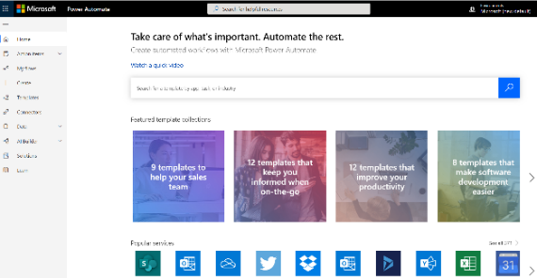
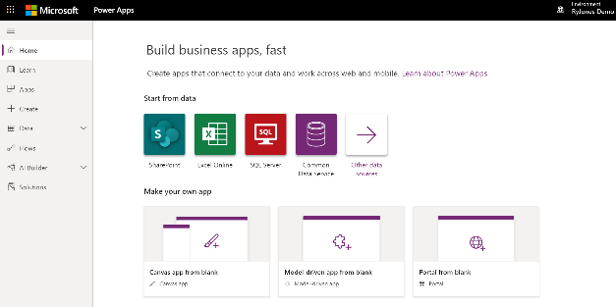
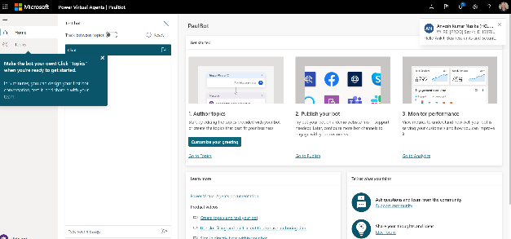
Resource level access
3
Resources can be shared in the following modes by the makers -
Access to co-own components – edit, share, use
Flow co-ownership sharing also shares connections in the flow implicitly with owners
Access to run components – use only
Power Automate
Power Apps
Power Virtual Agent

Slide 22
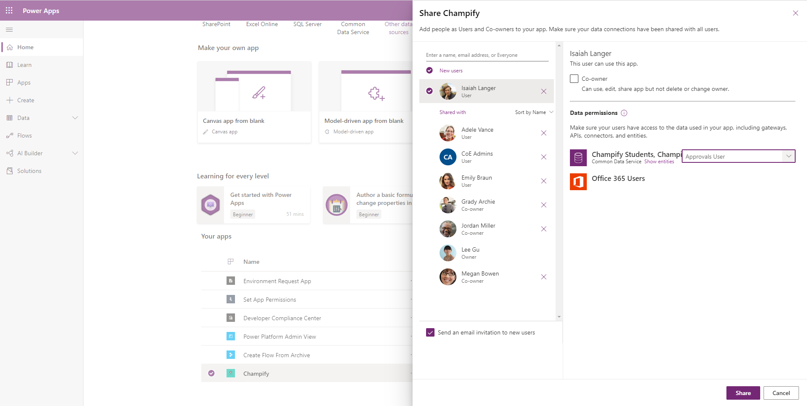
Sharing Component and Granting Data Access
3
Notes:
There are four roles that can be assigned in an environment which ensures granting privileges and permissions to users based on their job function.
Global, Power Platform, Delegated Admin
Complete ability to customize and administer the environment
Full read-write access to data in the database
The role cannot be modified
Care should be taken in assigning this to the right people
System Customizer
Full permission to customize the environment
Data access is focused only on data owned by the user
Role can be modified but it is not recommended to modify
Environment Maker
Create new resources in the environment including apps, connections, gateways and flows
There is no default privileges to data included
Role can be modified but it is not recommended to modify
Dataverse User
Basic user role, with ability to run apps and perform common tasks but no ability to customize the system
The data access is focused on Read access to most Common Data Model core entities with full access to records owned by the user (i.e. ‘self’ privileges)
Good role to copy to make a custom security role for users
Notes (09/24)
Blur out the faces or hide them

Slide 23
1
Azure Active Directory
Tenant access & isolation
TENANT
Dev
Test
2
Environment
Prod
Environment access & strategy
3
Resource permissions
Power Apps
Power Automate
Power Virtual Agents
4
Connector access and Data Loss Policies
Connectors
5
Dataverse security
Dataverse
6
On-premises data gateway
On-premises data gateway
Notes:
There are multiple layers to your security. Security begins at the tenant level and then cascades down to other elements. With regard to the Power Platform, there are security layers for Environments, resources, and the common data service. Also, it is important to ensure security across tenants. All organizations conduct business with partners and peers, and security data across organizations is as important as securing the data within your organization.

Slide 24
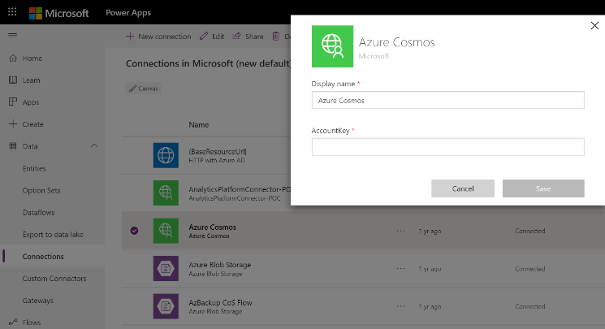
4
Connection Creation and Authentication
Apps and flows establish connection to the data source using prebuilt or custom connector in context of the user
User needs to authenticate based on the mechanisms supported by the connector to establish a connection
Typical connection types supported by connectors include – AAD, OAuth, APIKey, Windows Auth, Basic, No Auth etc. Some connectors may support multiple auth types
Existing AuthZ/AuthN rights of the user accrue upon establishing the connection
Canvas app connections can be edited, deleted and shared (if implicit sharing is allowed) by the connection creators
Notes:
Your DLP policies should be customized for each environment you create. The policies should match the unique needs and requirements for the environment. Admins also enjoy the flexibility of creating multiple policies for each environment.

Slide 25
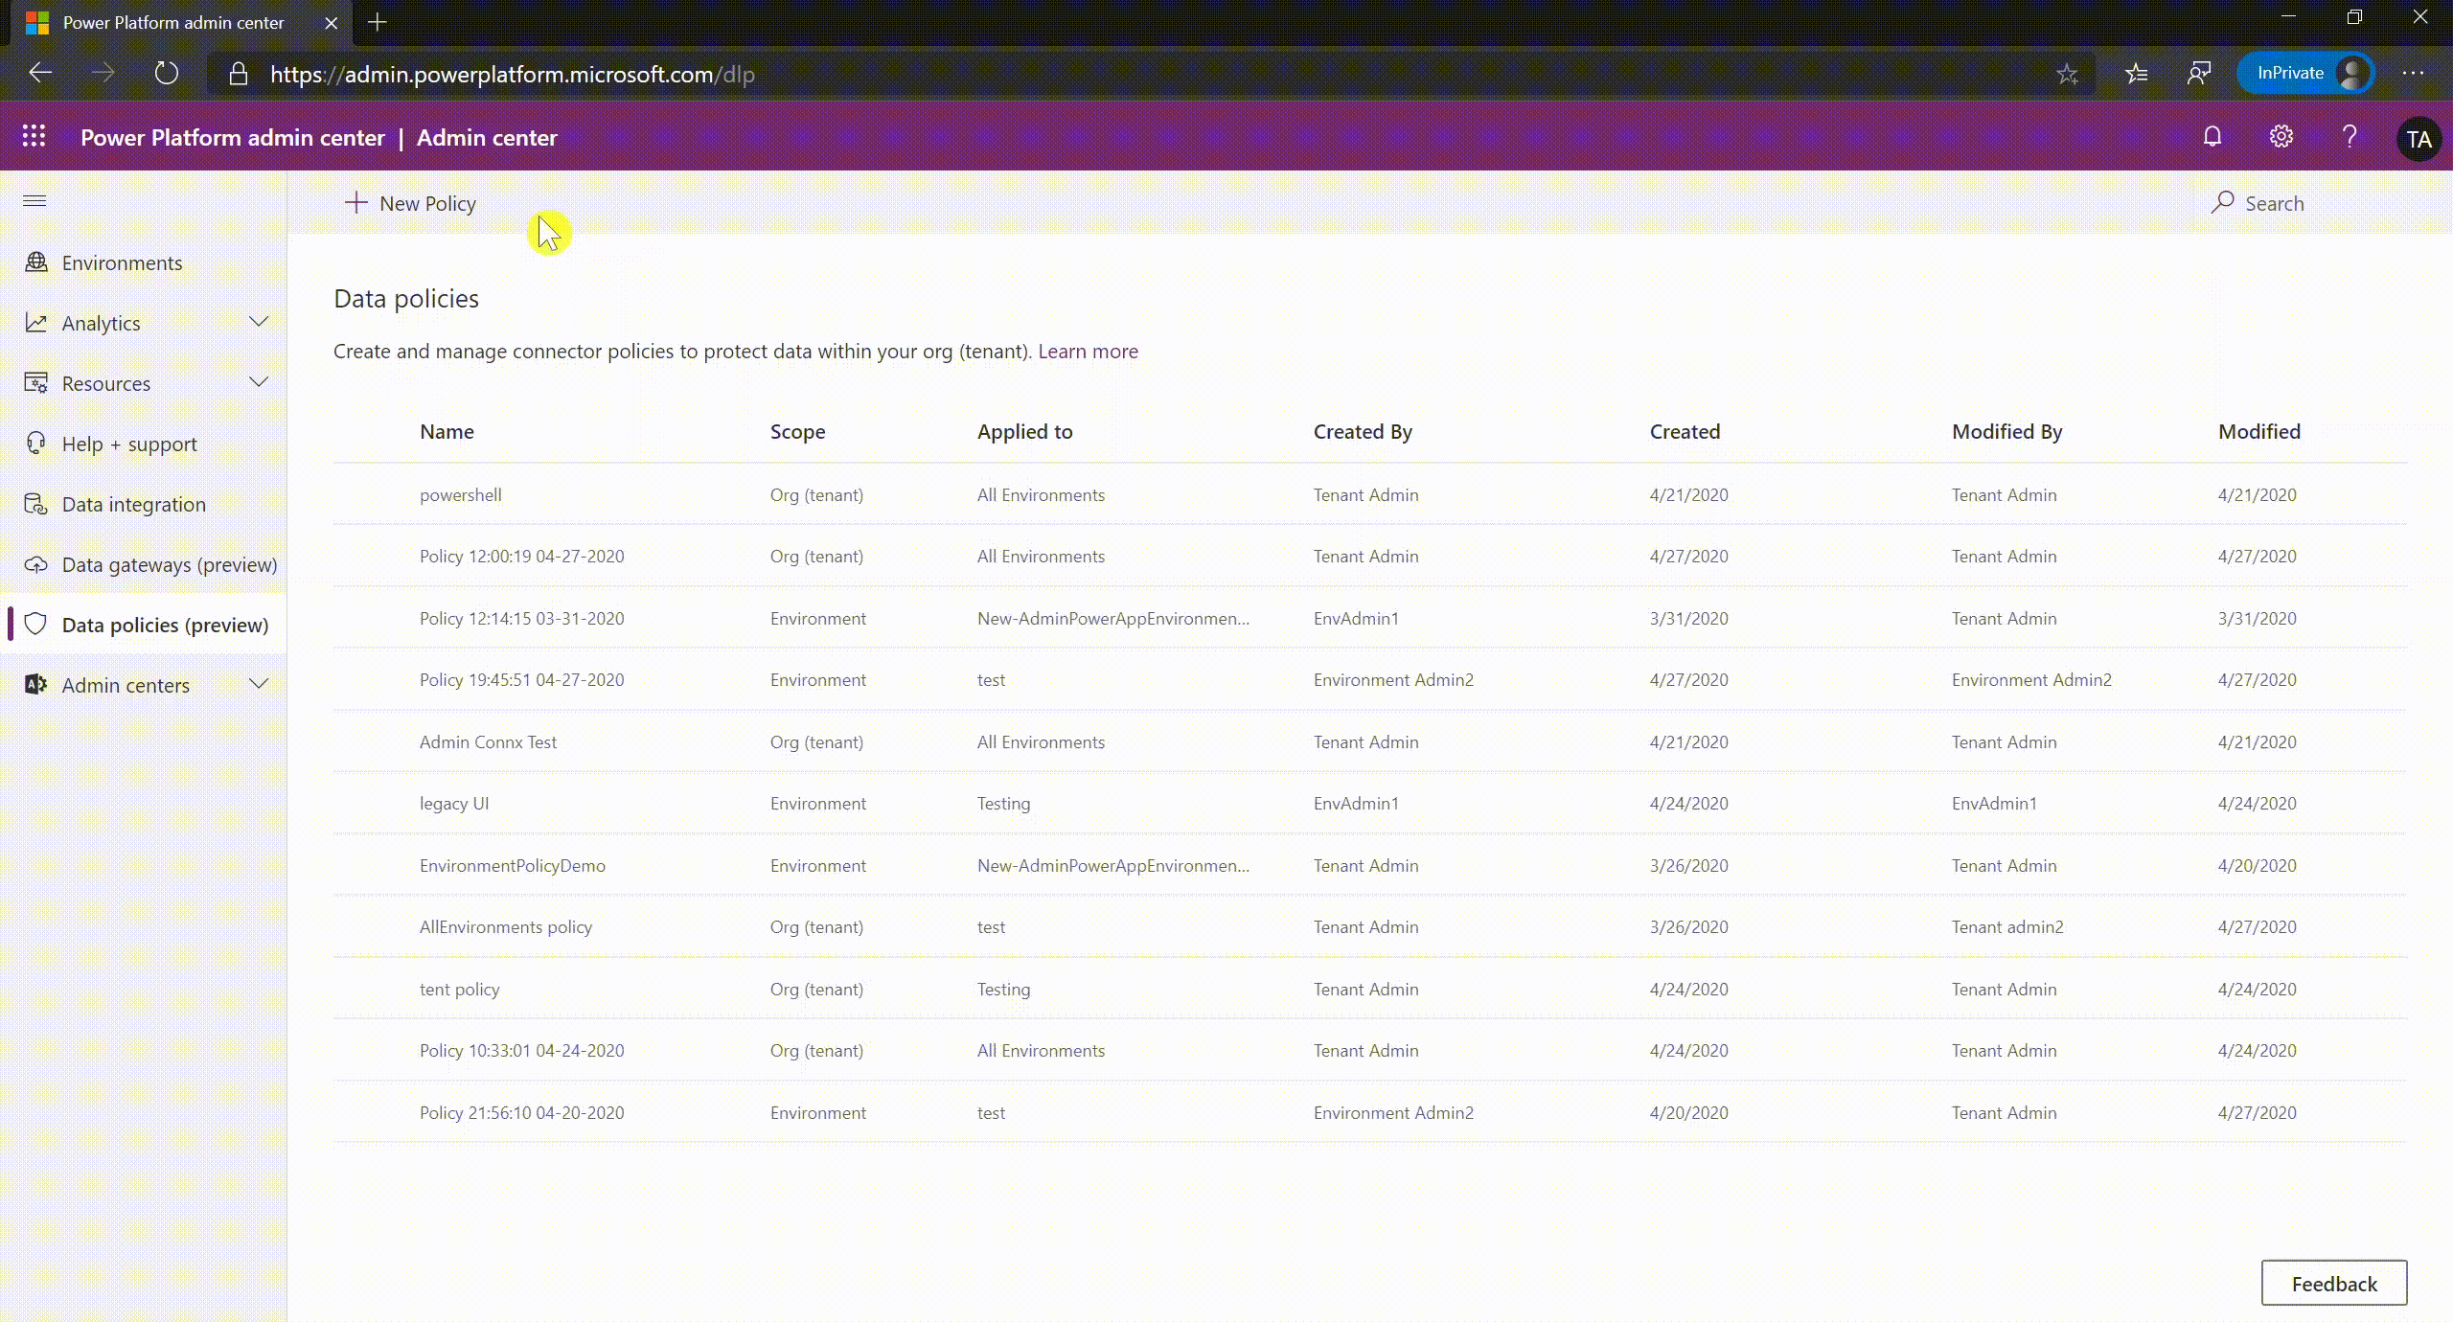
Power Platform DLP policies allow you to control data flows across data connectors when used within Power Apps and Power Automate.
Notes:
Simply put, DLP enables admins to isolate business data from personal use data within powerplatform.
They can do so by classifying power platform connectors across business and non-business groups using DLP. They can additionally choose to block certain connectors from use within power platform.
As you see on the user interface here the DLP policy allows admins to segregate connectors across three different buckets – Business, Non-business and blocked

Slide 26

4
Connector Classification
Business
A given Power App or Power Automate resource can use one or more connectors from Business group
If a Power App or Power Automate resource uses a Business connector, it cannot use any Non-business connector
Connectors can be classified across following groups using DLP policies
Non-business
A given Power App or Power Automate resource can use one or more connectors from Non-business group
If a Power App or Power Automate resource uses a Non-business connector, it cannot use any Business connector
Blocked
Any Power App or Power Automate resource cannot use any connector from Blocked group
All Microsoft owned premium connectors and third-party connectors (standard and premium) can be blocked
All Microsoft owned standard connectors and Microsoft Dataverse cannot be blocked
Notes:
So just to recap – power platform DLP supports three types of connector classification. Business and non-business groupings govern which connectors can be used together vs. not. Allowing you to segregate business sensitivie data from non-business data. Blocked on the other hand blocks the connector from use altogether. Power platform allows blocking of all Microsoft owned Premium connectors as well as all third party stanrrd and premium connectors.
However Microsoft owned standard connectors such a O365 and native Power platform connectors as well as Dataverse are not blockable and can only be classified as business/non-business.
Do please note that the DLP connector classification is not set in stone at the time of creating the policy. Admins can change the classification of connectors at a future time by editing the DLP policy based on thier evolving business needs.

Slide 27
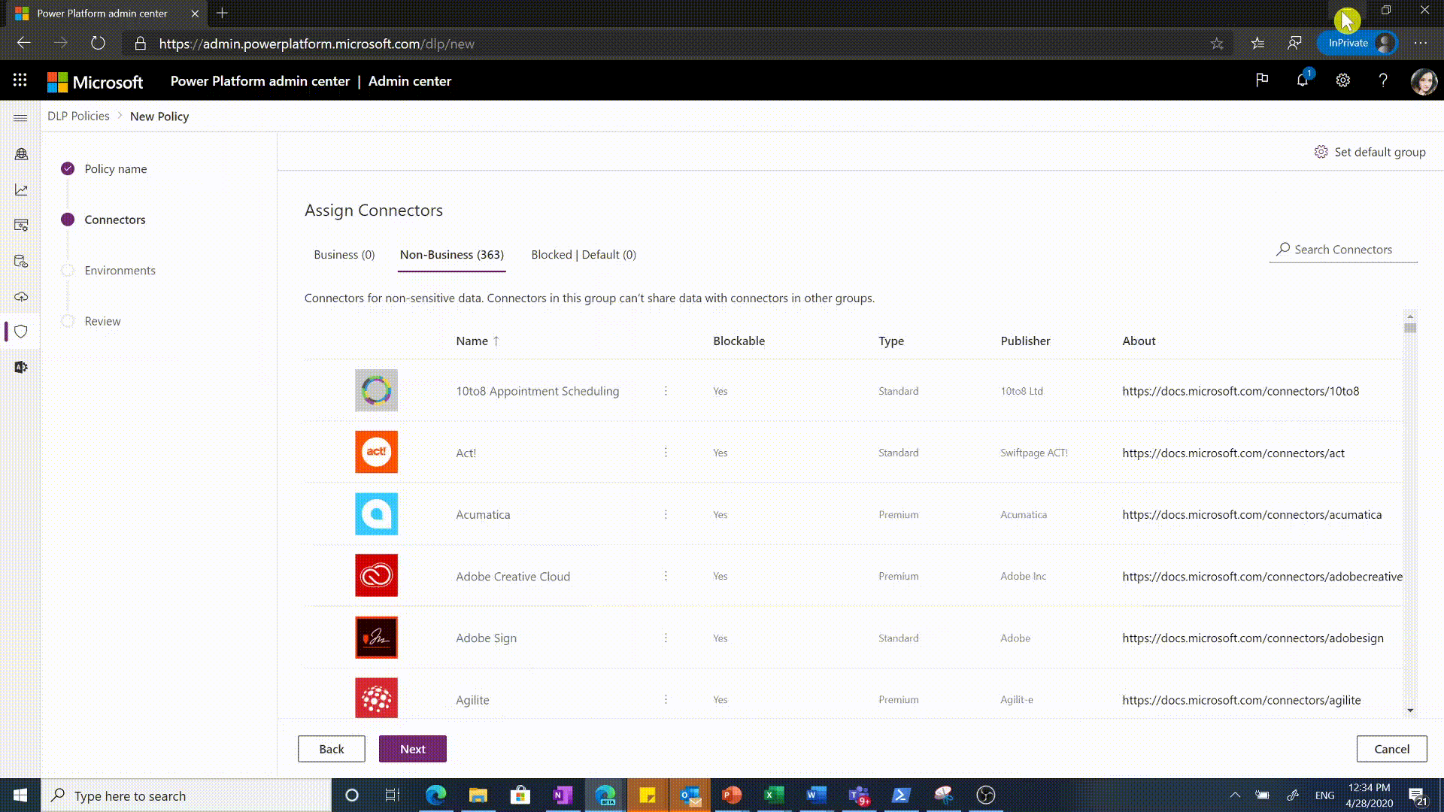
4
Connector default
Following grouping logic is applied to new connectors added to Power Platform:
Power Platform connector ecosystem keeps evolving and adding new connectors
If connectors are added after DLP policy creation, admins have not had a chance to explicitly categorize them.
These new connectors are automatically added to ‘default connector’ group identified for them
Admins can set the ‘default connector’ group for new connectors in a DLP policy to – Business or Non-business or Blocked
Admins can review these new connectors retrospectively and classify them explicitly as appropriate
Notes:
Before we move on from connectors to other DLP concepts, a quick note on what happens to the new connectors that get added to connector ecosystem *after* you have finished creating the DLP policy. As you can see here, there is a default categorization setting for new connectors that you can assign to your DLP policy. All three categories – Business, Non-Business and Blocked are available for you to choose from. Non-business is the default set up for new connectors if you don’t edit this setting.
For example say Power Platform introduces a new connector for Zendesk. Some organizations may use it for business scenarios and some may not. If the default grouping for new connectors in your DLP policy is set as blocked, when Zendesk gets introduced it will be mapped as a blocked connector. As admins note the new connector being available they can then review its details when they get time and move Zendesk to the appropriate business or non-business group by editing their DLP policy.
A small caveat - if you select ‘Blocked’ as the default categorization for new connectors is that if any Microsoft owned standard connectors are added which are exempt from blocking by definition, these will get mapped into non-business instead of blocked category. All other connectors would still map to blocked as expected.

Slide 28
4
Tenant and Environment Policies
Tenant level DLP policies
Supported only for - Power Platform Administrator, D365 Administrator or Global administrator - roles
Can be applied to one, more than one or all environments at a time
Can be edited and viewed by any tenant admin
Connector settings are visible to all relevant environment admins but are not editable by them
Can be used to manage custom connector patterns
Power Platform DLP allows admins to create two types of policies
Environment level DLP policies
Supported for Environment Admin role associated with the environment
Can be applied to only one environment at a time
Specifying the environment is mandatory to create the policy
Can be edited and viewed by any environment admin (of the environment) and tenant admins
Can be used to manage custom connector patterns
Notes:
Let us now look at the types of DLP policies. Power Platform supports– tenant level and environment level policies. The key difference between these two is that tenant level policies can be associated with more than one environment in the tenant, while the environment level policies only apply to a single environment at a time. Tenant level policies can only be created by tenant admin roles such as Power Platform administrator,. As mentioned earlier, tenant level policies are multi-environment and can be applied to one, more than one or all environments. These policies can be viewed and updated by any tenant admin even if they were not the original creator of the policy. Environment admins can also view tenant level policy settings since these do impact data flow for their environments. They are however not allowed to edit these policies. A key limitation for tenant level policies is – that they do not support custom connectors’ set up. This is because custom connectors are tied to a particular environment and are not available for multiple environments at a time.
Let us now look at environment level policies. These can be created by designated environment admins and have a 1:1 mapping to a single environment. All environment admins for the applicable environment as well as tenant admins can view and update environment level policies. Environment level policies do support custom connectors’ classification, through DLP powershell cmdlets. DLP UI support for custom connector classification is currently not available.

Slide 29
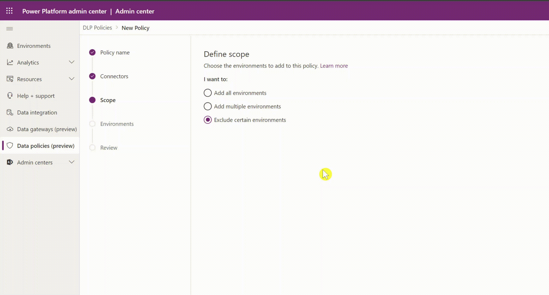
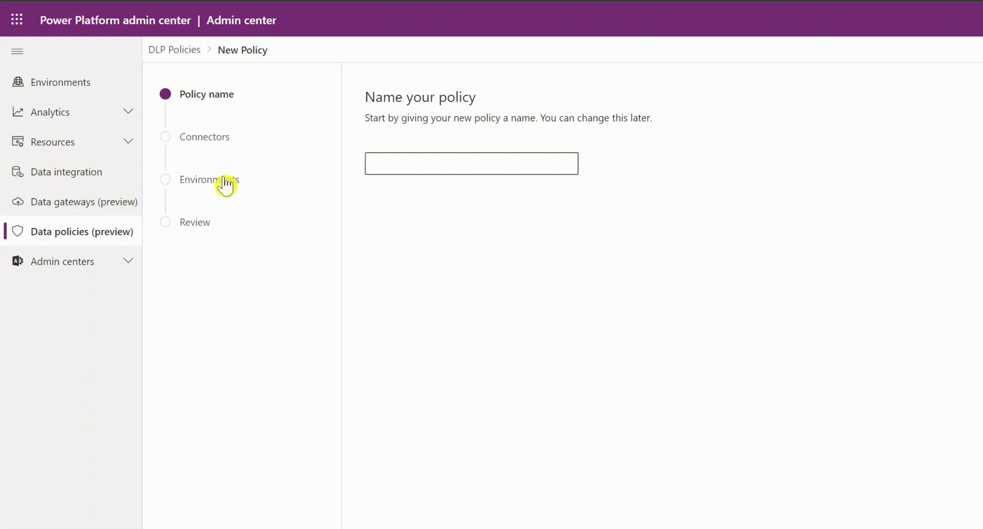
4
DLP Policy Scope
Tenant policies have three scope settings
All environments
By default tenant level policies will be applied to all environments created in the tenant
All except selected environments
Tenant admins can choose to exclude specific environments to apply the policy
Only selected environments
Tenant admins can choose to include only specific environments to apply the policy
Environment policies have one setting
One environment only
Environment admins can choose to apply the policy on one environment at a time
Notes:
Let us dive deeper into DLP policy’s environment scope setting across the two policy types. As mentioned, tenant level policies are multi-environment. They support three different scope settings for admins to choose from. By default tenant policies apply to ‘all environments’. Admins can however choose to exclude certain environments’ from DLP policy and apply it to the remaining environments. This will bring up the environment selection step to allow admins to exclude relevant environments. Alternately, admins can apply the policy only to select set of environments by choosing ‘add multiple environments’ option. This will also bring up the Environment selection step in the DLP policy wizard to choose the relevant environments to include. It is typical of tenant admins to use a complimentary combination of exclude environments and include environments policies to manage the unique connector settings for different stakeholders across their org. We will see one such example on the next slide.
On the other hand environment policies can only be applied to one environment at a time and environment selection is mandatory at the time of creating the policy. Multi-environment selection is not available for environment policies even if a particular environment admin may be managing more than one environment. They will need to create individual DLP policies for each environment they manage or coordinate with tenant admins to set up multi-environment tenant level policies. Do note that the DLP policy scope can be updated after the policy creation. Tenant admins can change the scope selection between the three available options as well as add or delete specific environments to the list. Simliarly environment admins can also change the environment to which the policy is applied.

Slide 30
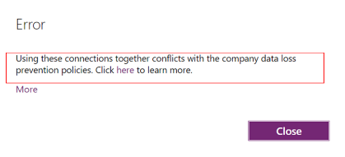
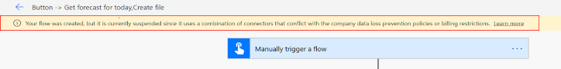
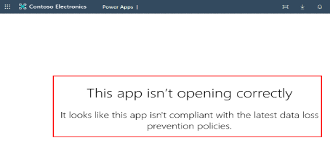
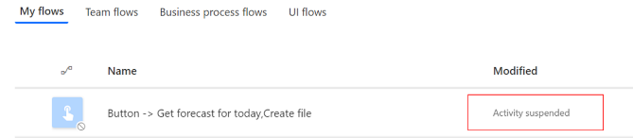
4
DLP Policy Enforcement
Design-time
Power Apps makers see an error upon using connectors that don’t belong together or are blocked using DLP policies. Apps violating DLP policies cannot be saved at design time unless DLP violation is resolved.
Power Automate makers see a warning while saving a flow using connectors that don’t below together or are blocked using DLP policies Flow will be saved but marked as ‘Suspended’ and will not execute unless DLP violation is resolved.
Run-time
If DLP policy changes impact an existing Power App negatively and it becomes non-compliant then users are no longer able to launch it and get an error.
If DLP policy changes impact an existing Power Automate negatively and it becomes non-compliant then it is automatically marked as suspended users are no longer able to execute it. Power Automate suspension may take ~5 mins to come into effect after policy changes.
Notes:
As expected, once admins create DLP policies and add appropriate environments in their scope, it restricts apps and flows from violating these policies at design time and at run time.
At design time app makers that are trying to use blocked connectors or mismatched connectors across business/non-business groups, get an error and are not allowed to save the violating connection in their app
Flow makers on the other hand are allowed to save such a flow but it is immediately marked as suspended along with appropriate warning to the maker. A suspended flow will not run until maker resolves the issue and brings the flow back into compliance.
Do note that even if an app or a flow may be working fine upon creation, it may still end up in violation of the DLP policies later in its lifecyle. This would typically happen as a side effect of admins updating existing DLP policies or creating new ones. This is where run-time enforcement for DLP policies comes in play. In this scenario, apps will check for latest DLP policies at launch time and will fail to launch with an error if they are in violation. Similarly existing flows will frequently poll against latest DLP policies and end up in a suspended state if they are in violation. The polling cycle for flow suspension can take order of minutes and is not instantaneous after DLP policy updation.
Makers can edit the apps and flows to bring them back into DLP compliance by removing the conflicting connections, and that will put their resource back into a functional state. Alternatively if there is a legitimate business need for a particular connection which current DLP settings do not accomodate, makers and admins can work together to figure out the right updates to existing environments and DLP policies, in order to unblock the business scenario without compomizing tenant’s security

Slide 31
4
Multiple Policy Impact on Environments
Blocked connectors
If a connector is marked as ‘blocked’ in any one DLP policy applied to the environment, then the net outcome is that this connector is blocked from usage within the environment
It doesn’t matter if other DLP policies applied to the environment mark it as business or non-business
If multiple tenant or environment level policies are applied simultaneously on an environment, then the most restrictive rules accrue
Business/Non-Business connectors
If all DLP policies applied to the environment mark certain set of connectors as business or non-business, then the most restrictive groupings define what connectors can be used together vs. not
For example –
Policy X = B {1,2,3} NB {4,5} ; Policy Y = B {3,4,5} NB {1,2}
Then –
Net outcome : {1,2} {3} {4,5}
Notes:
Lets dive into a complex topic now. The net outcome of multiple tenant and environment level policies is a regular source of questions and confusion that we hear related to power platform DLP. Essentially what happens in multi-policy scenario is that, all relevant policies appliable on an environment are evaluated one by one on apps and flows. In order for an app or flow to successfully execute in that environment, it has to comply to *all* DLP policies.
This concept is fairly easy to compute for blocked connectors. If a connector is marked as blocked in any one DLP policy associated with the environment, then that connector cannot be used in any app or flow in that environment, even if other policies consider it as business or non-business. ‘Blocked’ is the most restrictive grouping for a connector and it gets precedence over business or non-business classification.
It does get quite tricky to compute final outcome of connector mapping across multiple policies for business/non-business classification. As we have discussed earlier, business/non-business tag itself has no particular significance. The important thing that DLP policies define is rules around which connectors can be used together vs. not. As an example lets consider the scenario, where policy X and Y were both applied on the same environment. Here policy X identified connectors 1,2,3 to be usable together marking them as business and connectors 4, 5 are usable together marking them as non-business. On the other hand Policy Y considers connectors 3,4,5 to be usable together marking them as Business, while connectors 1 and 2 are placed together in the non-business group. Net outcome of these grouping restrictions when applied together ensure that connectors 1 and 2 can be used together, and 4 and 5 can be used together. However connector 3 cannot be used with any of the other 4 connectors. This is net outcome of policy X restricting its usage with 4 and 5, and policy Y restricting its usage with 1 and 2. Altogether the most restrictive settings ensure that connector 3 cannot be used with 1 and 2 as well as 4 and 5.

Slide 32












Multiple DLP Policy – Example Scenario
4
Business Group
POLICY X
Non-Business Group
Blocked Group
Target Environment
Business Group
POLICY Y
Non-Business Group
Blocked Group
PowerApps
Flows
Dataverse
Business Group
POLICY Z
Non-Business Group
Blocked Group
Multiple DLP policies applied to the same environment grouping connectors across Business/Non-business/Blocked. This set up makes the outcome of what connectors can be used together – Fragmented and hard to predict
Notes:
Lets use a more complex example to illustrate that multiple-policies applied on the same environment can fragment your connector space into unpredictable groupings.
Here we have three policies X, Y and Z subdividing the same 10 connectors across Business, Non-Business and Blcoked groups. All three policies are applied to the same target environment.
Here computing final outcome for Twitter and HTTP connectors will be fairly simple since they are marked as block in atleast one DLP policy. Remaining 8 connectors are going to be hard to predict given the difference in their settings across the 3 policies.

Slide 33

Multiple DLP Policy – Net Outcome
4
(PX.B, PY.B, PZ.B) Group 1
(PX.B, PY.B, PZ.NB) Group 2
(PX.B, PY.NB, PZ.B) Group 3
Target Environment
(PX.B, PY.NB, PZ.NB) Group 4
POLICY X
POLICY Y
POLICY Z
(PX.NB, PY.B, PZ.B) Group 5
(PX.NB, PY.B, PZ.NB) Group 6
PowerApps
Flows
Dataverse
(PX.NB, PY.NB, PZ.B) Group 7
(PX.NB, PY.NB, PZ.NB) Group 8
Blocked Group 9
All blocked connectors map to blocked. For business/non-business - 3 policies will fragment connector grouping outcome into as many as 3^2 = 8 different sets. For predictable outcomes use minimal number of DLP policies per environment
Notes:
Lets represent the final outcome of applying polices X, Y and Z on the same environment using the permutation of Business and non-business grouping across the 3 policies. This will give us 2 ^3 or 8 different possible permutations of connector groupings. Lets add a 9th group = that of blocked connectors.
We will place twitter and http in group 9 in keeping with the simple attribution of block connector being most restrictive DLP behavior.
Starting now with the first grup we will identify the connectors that are place in the business group across all three policies. This only bubbles up O365 video and O365 Users connectors which we will place in this group. Similarly we can plumb other 7 permutations.
Net outcome being – o365 video and users are the only connectors can be used together. Simiarly Azure IoT central and PowerBI are the only connectors that can be used together. SQL can only be used stnadlone, similarly for bing search. And lastly Microsoft translator and gmail can only be used with each other. Twitter and HTTP connectors cannot be used at all.
This combined outcome of 3 policies is hard to predict based on the individual policies’ set up. For predictable outcome of DLP settings we recommend to keep the number of simultaneous DLP policies active on any environment to a bare minimal. Regularly triage conflicting or overlapping policies and converge them into smaller number of policies.
This concludes our discussion on DLP concepts.

Slide 34
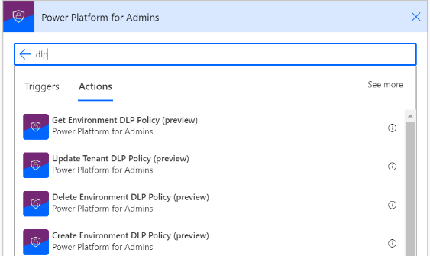
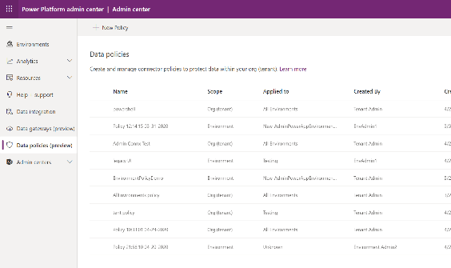
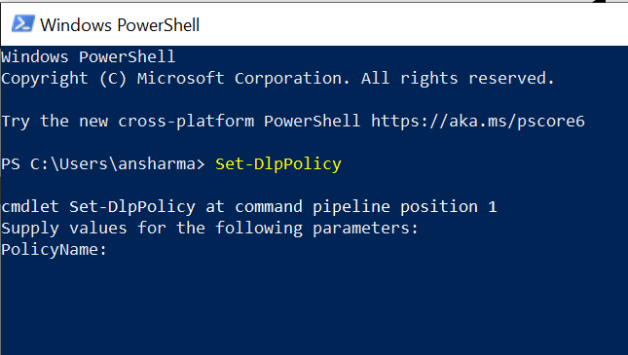
DLP Management Interfaces
4
Power Platform for Admins Connector
Power Platform Admin Center
Power Apps Powershell
Notes:
DLP polcies can be added, deleted, updated and viewed through three different admin interfaces, providing maximum flexibility to admins.
The primary user friendly interface to all things admin is the new power platform admin center and we have recently introduced the new DLP user interface in it. This new UI makes is very easy for admins to search and sort across 100s of connectors and 1000s of environments and easily define settings for them through multi-select and bulk-select options.
Power Platform Admin connector can also be used to perform CRUD operations on DLP policies for your custom governance workflows from within power platform. This is a greate example of using power platform to manage power platform
And last but certainly not the least, Power apps admin powershell interface can be used for automating all your DLP management functions for power platform including management of custom connectors

Slide 35
1
Azure Active Directory
Tenant access & isolation
TENANT
Dev
Test
2
Environment
Prod
Environment access & strategy
3
Resource permissions
Power Apps
Power Automate
Power Virtual Agents
4
Connector access and data loss policies
Connectors
Dataverse
5
Dataverse security
6
On-premises data gateway
On-premises data gateway
Notes:
There are multiple layers to your security. Security begins at the tenant level and then cascades down to other elements. With regard to the Power Platform, there are security layers for Environments, resources, and the common data service. Also, it is important to ensure security across tenants. All organizations conduct business with partners and peers, and security data across organizations is as important as securing the data within your organization.

Slide 36
Security Roles and Privileges
5
Privileges
Record-level privileges.
For each entity, permissions can be defined for Read, Create, Delete, Write, Assign, Share, Append and Append To.
Action/Task-based privileges.
Permissions can also be defined for non-entity related actions, e.g. publish articles.
Different level of accesses:
Global
Deep
Local
Basic
Roles
Define how different users access different types of records
Contain a set of privileges
Users can be assigned to multiple security roles
Security role privileges are cumulative
Notes:
Record-level:
For each entity, definitions of access level for CRUD operations are defined
Action/Task-based
For non-entity related permissions
Cumulative privileges:
When users are assigned multiple security roles, users get the cumulative privileges of all the roles.

Slide 37
Record-level security
5
Table
Access Level
Privilege | Description
Create | Required to make a new record. Which records can be created depends on the access level of the permission defined in your security role.
Read | Required to open a record to view the contents. Which records can be read depends on the access level of the permission defined in your security role.
Write | Required to make changes to a record. Which records can be changed depends on the access level defined in your security role.
Delete | Required to permanently remove a record. Which records can be deleted depends on the access level of the permission defined in your security role.
Append | Required to associate a record with the current record. For example, if a user has Append rights on an opportunity, the user can add a note to an opportunity. Which records can be appended depends on the access level of the permission defined in your security role.
Append To | Required to associate the current record with another record e.g., a note can be attached to an opportunity if the user has Append To rights on the note. Which records can be appended to depends on the access level of the permission defined in your security role.
Assign | Required to give ownership of a record to another user. Which records can be assigned depends on the access level of the permission defined in your security role.
Share | Required to give access to a record to another user while keeping your own access. Which records can be shared depends on the access level of the permission defined in your security role.
Access | Description
 | Global. This access level gives a user access to all records in the organization, regardless of the business unit hierarchical level that the environment or the user belongs to. Users who have Global access automatically have Deep, Local, and Basic access. The application refers to this access level as Organization.
 | Deep. This access level gives a user access to records in the user's business unit and all business units subordinate to the user's business unit. Users who have Deep access automatically have Local and Basic access, also. The application refers to this access level as Parent: Child Business Units.
 | Local. This access level gives a user access to records in the user's business unit. Users who have Local access automatically have Basic access, also. The application refers to this access level as Business Unit.
 | Basic. This access level gives a user access to records that the user owns, objects that are shared with the user, and objects that are shared with a team that the user is a member of. This is the typical level of access for sales and service representatives. The application refers to this access level as User.
 | None. No access is allowed.
Notes:
Row level
For each entity, definitions for CRUD operation privileges can be set
Access level
For each permission, definitions of access levels can be set

Slide 38
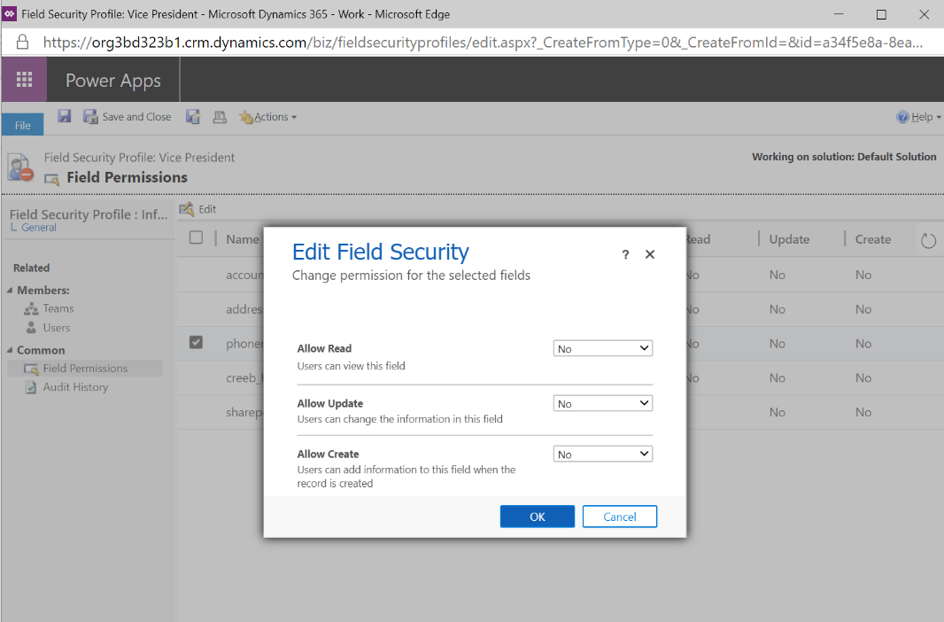
Field level security
5
Control access to sensitive data
Can be used in:
Client applications – Web, mobile, Microsoft Dynamics for Outlook
Web service calls – plugins, workflow, custom code
Reporting (via Filtered views)
Enforce by security profile for:
Users and Teams
Permission Scope:
Read
Create
Update
Exceptions (do not support FLS)
Identifiers – ownerId, contactId, accountId, etc
Security principal fields – createdBy, modifiedBy, Owning Team/User
Timestamp
Codes – state, status

Slide 39
1
Azure Active Directory
Tenant access & isolation
TENANT
Dev
Test
2
Environment
Prod
Environment access & strategy
3
Resource permissions
Power Apps
Power Automate
Power Virtual Agents
4
Connector access and data loss policies
Connectors
5
Dataverse security
Dataverse
6
On-premises data gateway
On-premises data gateway
Notes:
There are multiple layers to your security. Security begins at the tenant level and then cascades down to other elements. With regard to the Power Platform, there are security layers for Environments, resources, and the common data service. Also, it is important to ensure security across tenants. All organizations conduct business with partners and peers, and security data across organizations is as important as securing the data within your organization.

Slide 40

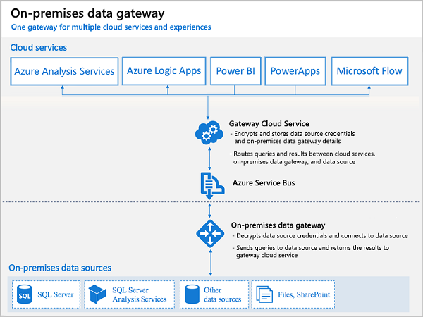
On-premise Gateway - Key Facts
6
Allows Power Apps and Power Automate to reach on-premises resources for hybrid integration scenarios.
Leverages Azure Service Bus relay technology to securely allow access to on-premises resources.
The gateway service must run on a local server in your on-premises location
Setting up a data source on the gateway requires credentials that are encrypted securely. All access to data uses these creds
The gateway service creates an outbound connection to Azure Service Bus on ports: TCP 443(default), 5671, 5672, 9350 through 9354.
Notes:
This is a good example.

Slide 41
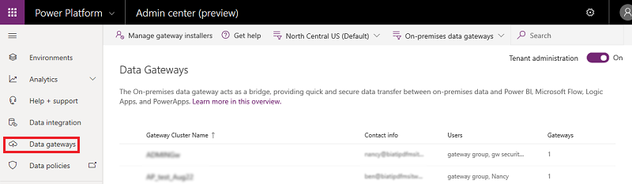
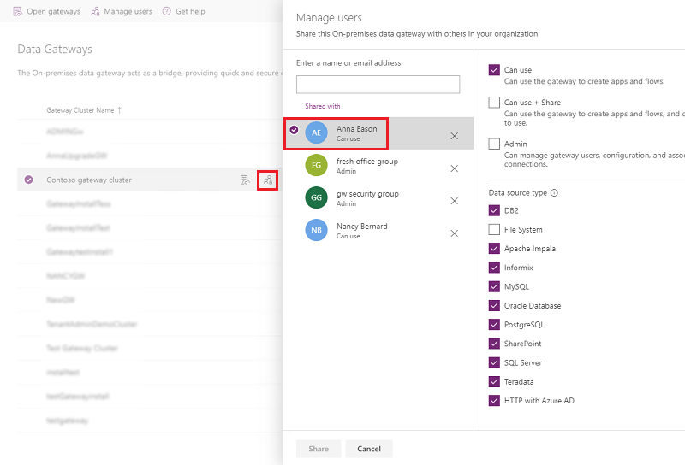
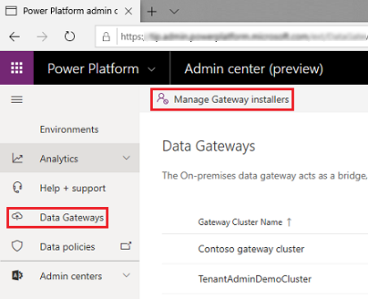
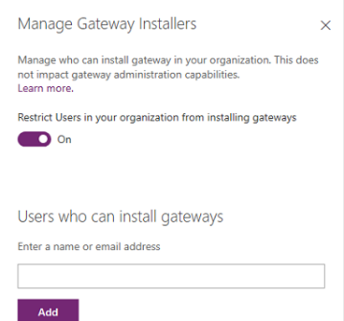
6
Capabilities
Manage gateways entirely in the Power Platform admin center. Learn more here.
Manage users in 3 different categories (admins, can use, and can use + share). Learn more here.
Manage who can install the on-premises data gateway in your enterprise. Learn more here.
MICROSOFT CONFIDENTIAL
Notes:
https://aka.ms/adtenantrestrictions

